Slide 1

Revolutionizing the Auto Parts Industry: Exploring the Unique Features of Clarkton Corporation, an E-Commerce Website Developed by Worcester IT Solutions

Slide 2

Convenience and Accessibility
01.
About the project
02.
Features
03.
User Friendly UI
04.
Payment Options
05.
Product Delivery
06.
Conclusion

Slide 3
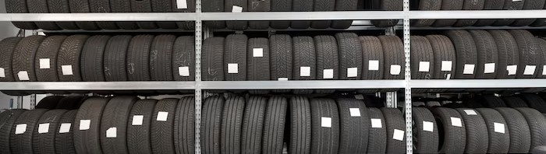
About the project
What and all we need to know
Clarkton Corporation offers a wide range of auto parts, from engine components to brake pads and everything in between.
With a comprehensive inventory of products from top manufacturers, customers can ﬁnd exactly what they need for their vehicles on Clarkton Corporation.

Slide 4
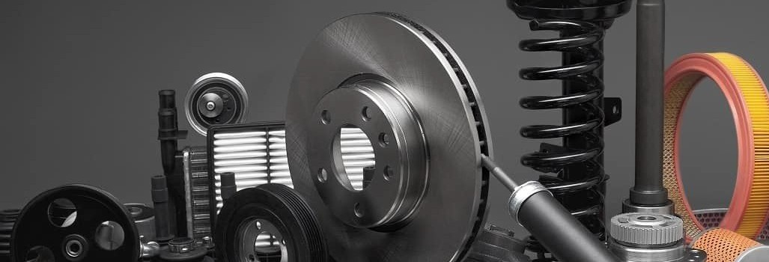
What Software can do
This unique software has features like target search about the parts and it also has categories as engine parts, cosmetic products, interior accessories etc. These features makes customer to select the product from wide range of options available in the website.
With it's features

Slide 5

Easy and Simple Usage
With User Firendly UI
Clarkton Corporation's user interface is designed with simplicity and ease of use in mind, ensuring a seamless and enjoyable browsing experience for users. The UI features intuitive navigation, allowing users to effortlessly browse through the auto parts inventory and locate what they need. A clean and organized layout provides a clear display of products, with helpful ﬁlters and search options to reﬁne results swiftly. The incorporation of visually appealing icons, straightforward menus, and a logical ﬂow of actions enhances user engagement and comprehension. Additionally, the UI emphasizes user feedback and assistance, making it easy for customers to get support or ﬁnd information, fostering a positive interaction and driving customer satisfaction.

Slide 6

Secure Payment Options
With Stripe
Stripe is a widely used online payment processing platform that enables businesses and individuals to conduct ﬁnancial transactions over the internet securely and efﬁciently. It provides a seamless way to handle payments, manage subscriptions, and handle other e-commerce transactions. With its developer-friendly interface and robust set of tools, Stripe allows for easy integration into various websites and applications. It supports a variety of payment methods, including credit cards, digital wallets, and bank transfers, making it versatile and accessible to a global audience. Additionally, Stripe offers features like fraud prevention, subscription billing, real- time analytics, and a user-friendly dashboard, making it a popular choice for businesses of all sizes seeking reliable payment solutions.

Slide 7

With Our Agencies
Fast and Assured Free Delivery
Clarkton Corporation prioritizes the best and safest delivery experience for our customers. We have implemented a streamlined and efﬁcient delivery process that ensures timely and secure transportation of auto parts. Our dedicated logistics team meticulously coordinates deliveries, utilizing reliable carriers and optimized routes to minimize transit times and reduce any potential risks. Moreover, we prioritize robust packaging to safeguard the integrity of the auto parts during transportation, employing industry-leading packaging materials and methods. Our commitment to delivering excellence extends beyond speed; we focus on reliability, real-time tracking, and proactive communication to keep customers informed and provide peace of mind throughout the entire delivery journey. Clarkton Corporation strives to exceed expectations, guaranteeing a seamless and secure delivery experience for all our valued customers.

Slide 8

Conclusion
Clarkton Corporation is revolutionizing the auto parts industry with its user-friendly e- commerce platform, competitive pricing, wide range of products, secure payment options, 24/7 customer support, and fast and reliable shipping. As the industry continues to evolve, Clarkton Corporation is leading the way in innovation and customer satisfaction.

Slide 9
Thanks!
Do you have any questions?
Clarkton.Inc
+1 774 519 8858
ClarktonCorporation.com
Main St, Worcester - 01610
@Worcester IT Solution Inc

